Slide 1


Real Time Assistive Shoe for Visually Impaired People using IoT
By
Arthi R Vemuri Jyothi Kiran
Anukiruthika R.L Mathan Krishna
Utkalika Das
Department of Electronics and Communication Engineering SRM Institute of Science and Technology, Ramapuram Chennai, India

Slide 2
TABLE OF CONTENTS
Introduction
Motivation
Objectives
Literature survey
Work done
Results and Discussion
References

Slide 3
INTRODUCTION
The visually impaired community faces many challenges in navigating their environment, particularly when it comes to mobility and safety.
However, with the advent of Internet of Things (IoT) technology, new opportunities have emerged to develop assistive devices.
It represents an exciting advancement in the field of assistive technology.
The proposed Real Time Assistive system explores the key features of this innovative shoe, as well as its potential benefits for the visually impaired community.

Slide 4
MOTIVATION
By providing real-time feedback on the user's surroundings, the shoe can help to prevent accidents and injuries.
While also enabling the user to navigate more effectively in a variety of environments.
These benefits include enhanced mobility, greater independence, and increased safety for the visually impaired.
It helps visually impaired people to be capable to identify impediments on their route while advancing from one spot to another.

Slide 5
OBJECTIVE
Real-time assistive shoe designed and developed to facilitate safe navigation and mobility of visually impaired individuals.
It is controlled by battery operation, cloud storage and involves the use of IoT automation features.
This results in enhancing the understanding of the issues the visually impaired face.
The development of shoes is important to enhance mobility, safety, and independence.

Slide 6

Literature review
REFERNCE NOS | PAPER TITLE | JOURNAL AND YEAR OF PUBLICATION | INFERENCE
[1] | Smart cane for blind and visually impaired persons. | International Journal of Creative Research Thoughts,2020 | Most technical assistance services aim, at assisting people with disabilities rely on the use of cane
[2] | Low-Cost Smart Shoe for Visually Impaired. | Third International Conference on Intelligent Communication Technologies and Virtual Mobile Networks,2021 | The author has aimed of this idea is to develop low-cost, high precision smart shoe for the visually impaired.
[3] | Construction of smart shoe system for visually impaired people. | Int J Res Analyst Rev, 2019. | Transmits information through haptic feedback that is done using buzzers producing beeps
[4] | Real-time assistive shoe for visually impaired people | 26th International Conference for Convergence in Technology,2021 | Identifying the type of obstacle using sensors and detecting fall

Slide 7

REFERENCE NOS | PAPER TITLE | JOURNAL AND YEAR OF PUBLICATION | INFERENCE
[5] | Low-Cost Smart Shoe for Visually Impaired | Third International Conference on Intelligent Communication Technologies and Virtual Mobile Networks (ICICV),2021 | The ultrasonic sensor works in a range of 10 meters and provide detection of obstacle
[6] | Smart Assistive Shoes with Internet of Things Implementation for Visually Impaired People | In Journal of Physics,2021 | The pair of infrared sensors can be able to detect the obstacles in the user pathway, may it be a pit or stone or living being or anything
[7] | Design of Smart Walking Shoe for Visually Impaired People | Journal of Advanced Research in Applied Mechanics,2023 | Node MCU gives live GPS tracking after request for location is sent by parents, friends ,or caretaker through sim 800L
[8] | A Smart Assistive System for Visually Impaired to Inform Acquaintance Using Image Processing (ML) Supported by IoT | Hybrid Artificial Intelligence and IoT in Healthcare,2021 | An important task of face recognition and recognition algorithms is used.
[9] | An Intelligent Voice Assistance System for Visually Impaired using Deep Learning | In 2022 International Conference on Decision Aid Sciences and Applications, 2022 | It provides higher accessibility and comfort, as well as simplicity of navigation for visually impaired people

Slide 8
WORK DONE
The proposed work suggests advanced awareness of the issues that individuals with vision impairments confront daily.
For visually impaired people to be capable to identify impediments on their route while advancing from one spot to another.
Additionally, there are incidents, injuries, and accidents which protect them from their circumstances.
A user-friendly combination of hardware and software is a smart shoe for individuals who are blind or visually impaired.
Other sensors, such as the HC-SR04, MQ135, PIR sensor, moisture sensor, and MPO6050, have been connected to the Arduino Uno for use in portable electronic devices.

Slide 9
For visually impaired people to be able to recognize obstacles on their way when heading from one site to another, electronic travel assistance is crucial.
Furthermore, there are incidents, mishaps, and injuries that lessen the impact they have.
The sensor utilized determines what kind of impediment is striking the shoe or coming closer.
On the other hand, we have an array of sensors connected to MCR104, DSMB120, HC7EN, and LM393 that can distinguish the type of obstruction.

Slide 10
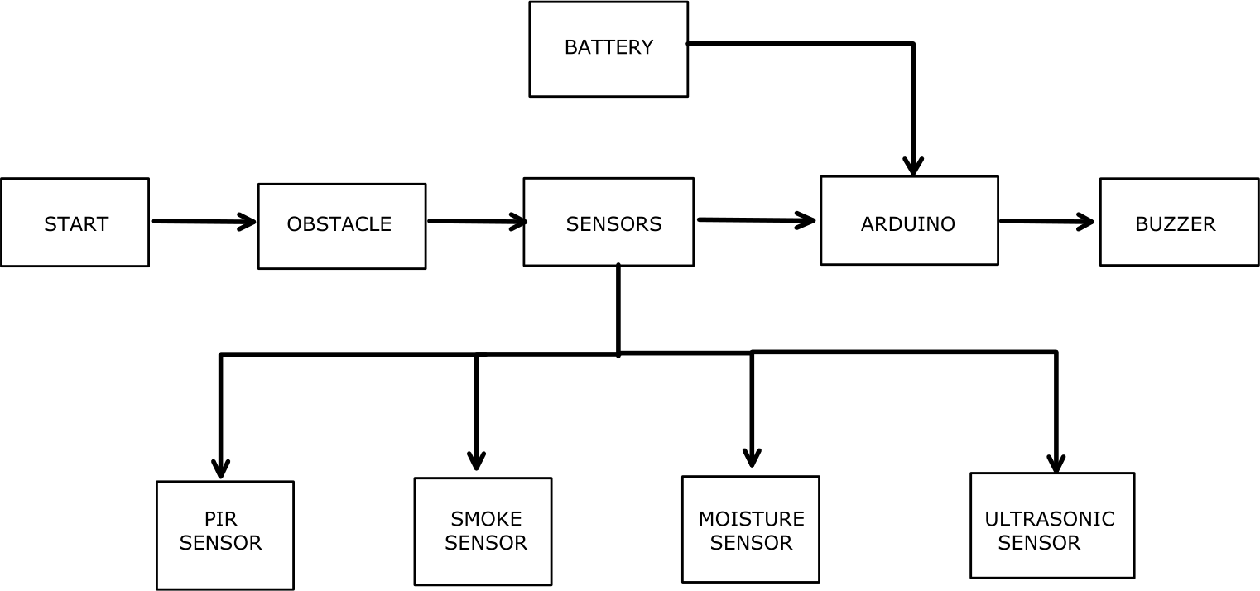
BLOCK DIAGRAM
fig.1.block diagram

Slide 11
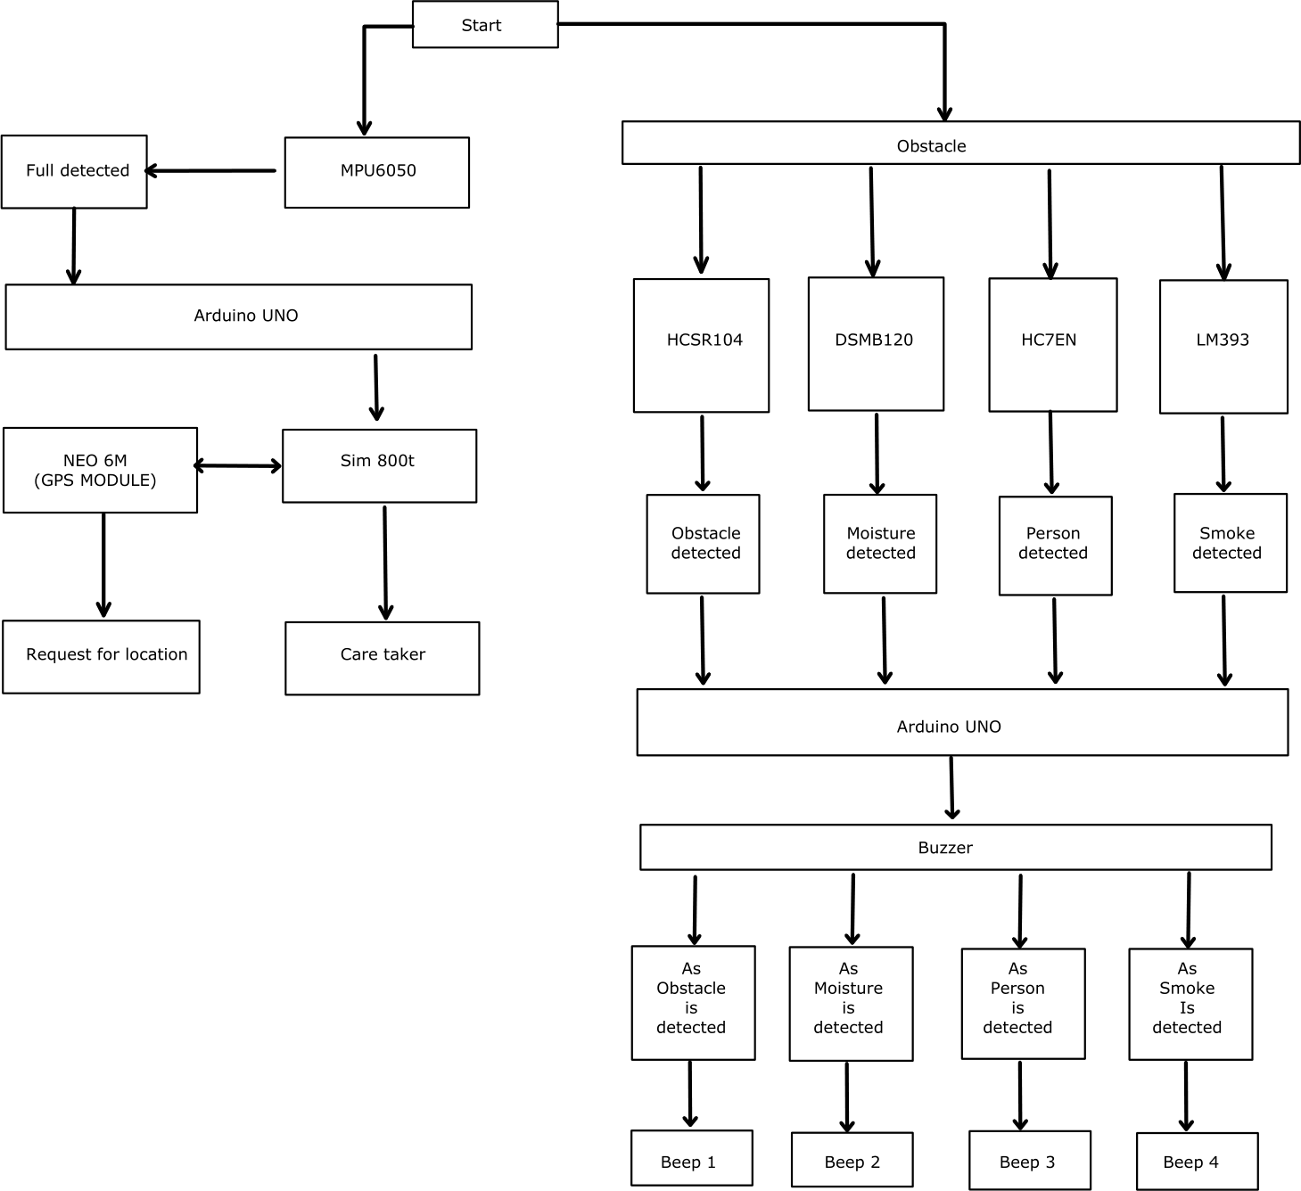
ARCHITECTURE
fig.2.Architectural diagram

Slide 12
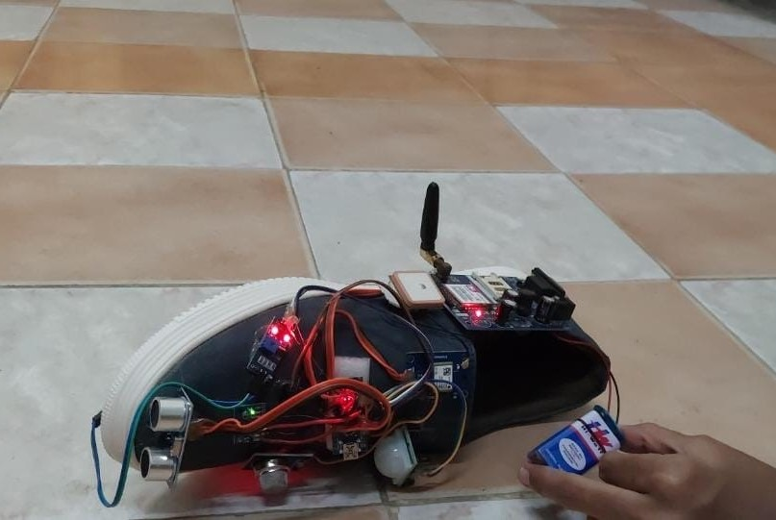
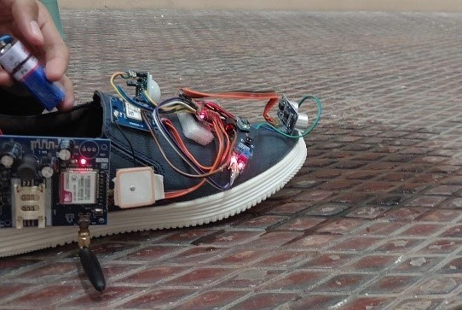
HARDWARE PROTOTYPE
fig.3.obstacle detection
fig.4.moist detection

Slide 13
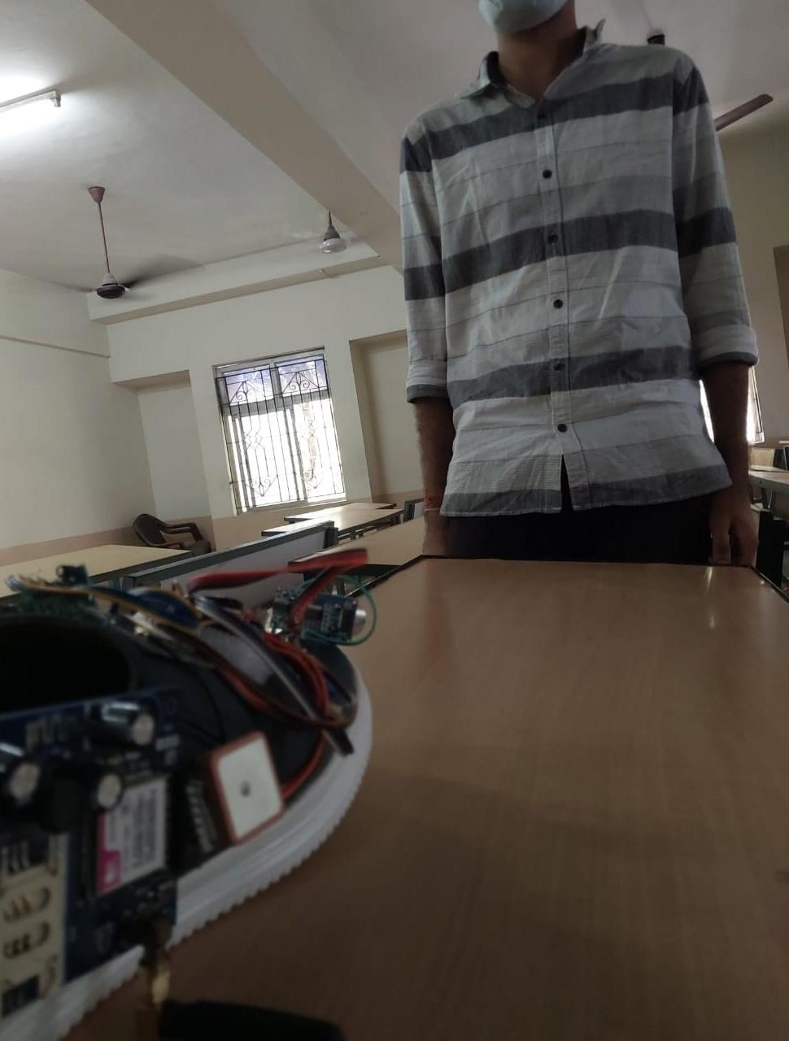
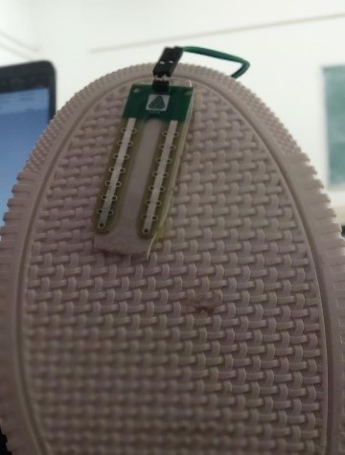
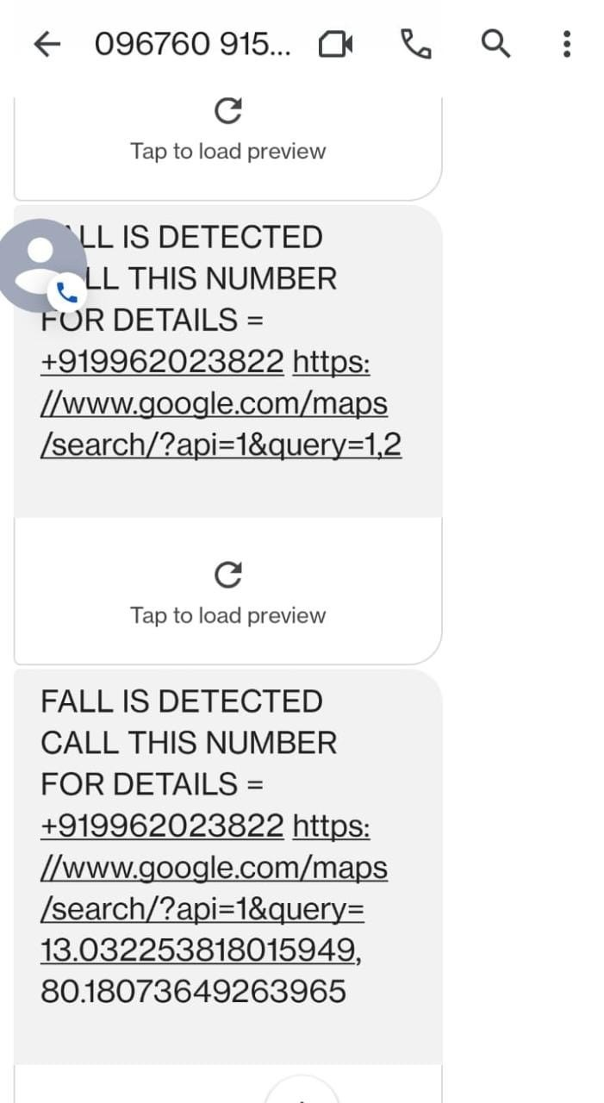


fig.5.human detection
fig.6.moist sensor
fig.7.fall detection message

Slide 14
RESULTS AND DISCUSSION
The system utilizes various IoT technologies such as GPS, Bluetooth, and sensors to provide real-time audio feedback to the user about their surroundings, including obstacles, location, and direction.
By incorporating machine learning algorithms, the shoe can learn and adapt to the user's walking pattern, providing more accurate feedback over time.
Overall, the Real Time Assistive Shoe for Visually Impaired People using IoT is a promising technology that has the potential to enhance the quality of life and independence of visually impaired individuals, and it is a significant step towards creating more inclusive and accessible communities.

Slide 15
REFERENCES
Yohannan, Alex, and Shilpa Shyam. "Smart cane for blind and visually impaired persons," International Journal of Creative Research Thoughts, vol. 8, No. 5, 2513-2517, 2020.
Anisha, M., S. Kirthika, D. Jemimah Harline, P. Thenmozhi, R. Rubala, T. Girija Pragathi, M. Benisha, and C. Jim Elliot. "Low-Cost Smart Shoe for Visually
Impaired," In 2021 Third International Conference on Intelligent Communication Technologies and Virtual Mobile Networks (ICICV), pp. 1108-1111. IEEE, 2021.
Koli, Pooja S., Nikita Sunil Chavan, and Shraddha Gajanan Gaikar. "Construction of smart shoe system for visually impaired people," Int J Res Analyt Rev, vol. 6, No. 1, 2349-5138, 2019.
Kumar, Pradeep, K. M. Inchara, S. Lekhashree, C. N. Likhith, and U. Pavan. "Real time assistive shoe for visually impaired people," In 2021 6th International Conference for Convergence in Technology (I2CT), pp. 1-5. IEEE, 2021.
Anisha, M., S. Kirthika, D. Jemimah Harline, P. Thenmozhi, R. Rubala, T. Girija Pragathi, M. Benisha, and C. Jim Elliot. "Low-Cost Smart Shoe for Visually
Impaired," In 2021 Third International Conference on Intelligent Communication Technologies and Virtual Mobile Networks (ICICV), pp. 1108-1111. IEEE, 2021.
NKamaruddin, F. S., N. H. Mahmood, MA Abdul Razak, and N. A. Zakaria. "Smart Assistive Shoes with Internet of Things Implementation for Visually Impaired People." In Journal of Physics: Conference Series, vol. 2107, no. 1, p. 012030. IOP Publishing, 2021.
athan, Shelena Soosay, Kuan Jung Ying, Lim Hui Wen, and Lim Xin Weoi. "Design of Smart Walking Shoe for Visually Impaired People." Journal of Advanced Research in Applied Mechanics, vol. 101, no. 1, 53-61, 2023.
Aravindan, C., R. Arthi, R. Kishankumar, V. Gokul, and S. Giridaran. "A Smart Assistive System for Visually Impaired to Inform Acquaintance Using Image Processing (ML) Supported by IoT." Hybrid Artificial Intelligence and IoT in Healthcare, pp.149-164, 2021.
Varghese, Renju Rachel, Pramod Mathew Jacob, Midhun Shaji, R. Abhijith, Emil Saji John, and Sebin Beebi Philip. "An Intelligent Voice Assistance System for Visually Impaired using Deep Learning." In 2022 International Conference on Decision Aid Sciences and Applications (DASA), pp. 449-453. IEEE, 2022.

Slide 16
THANK YOU

